Slide 1
ANATOMIA E FISIOLOGIA DEL GIUNTO GASTROESOFAGEO
LUIGI ANGRISANI
Associate Professor of General Surgery
Department of Public Health, “Federico II”
University, Naples, Italy

Slide 2
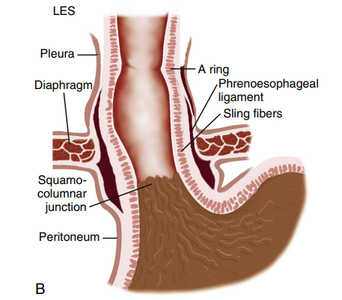
Esophago-gastric Junction (EGJ)
The distal end of the esophagus is anchored to the diaphragm by the phrenoesophageal membrane. Significant contributors to the EGJ high-pressure zone are: the LES, the crural diaphragm, and the muscular architecture of the gastric cardia.
The LES is a 3- to 4-cm segment of tonically contracted smooth muscle at the distal extreme of the tubular esophagus
Angrisani 2024

Slide 3
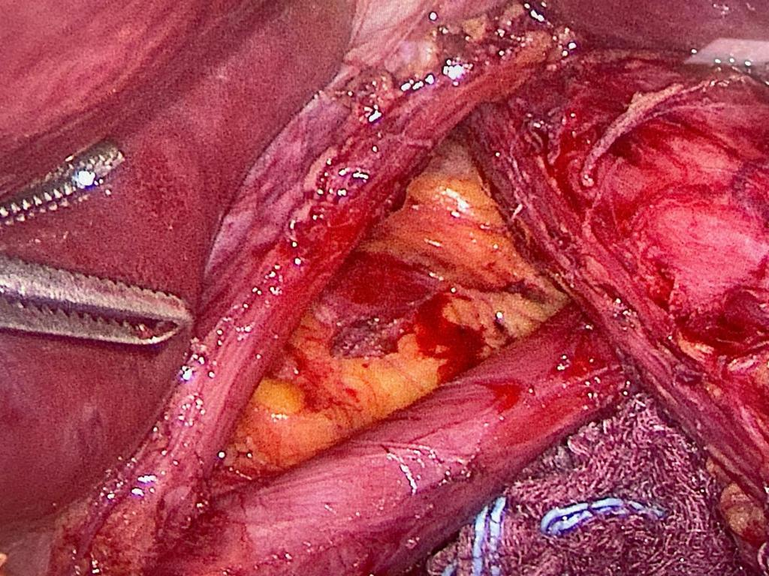
Esophago-gastric Junction (EGJ)
Surrounding the LES at the level of the SCJ is the crural diaphragm, most commonly bundles of the right diaphragmatic crus forming a teardrop-shaped canal
about 2 cm long on its major axis.
Angrisani 2024

Slide 4
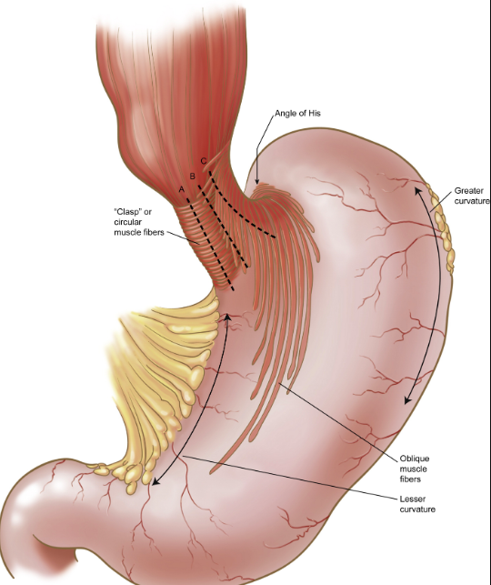
Esophago-gastric Junction (EGJ)
Clasps and Slings fibers. The muscle fibers of the proximal stomach that make up the distal portion of the LES. The gastric sling fibers are the continuation of the inner circular fibers of the distal esophagus (i.e. clasps fibers) and when contracted will “pull down” and accentuate the angle of Hiss as an anti-reflux mechanism
Angrisani 2024

Slide 5
Angrisani 2024
Sugano et al.
Gut, 2022
Notes:
HH can be endoscopically diagnosed by measuring the axial length between the squamocolumnar junction and the diaphragmatic pinch or by assessing the gastroesophageal flap valve using the Hill Classification.

Slide 6
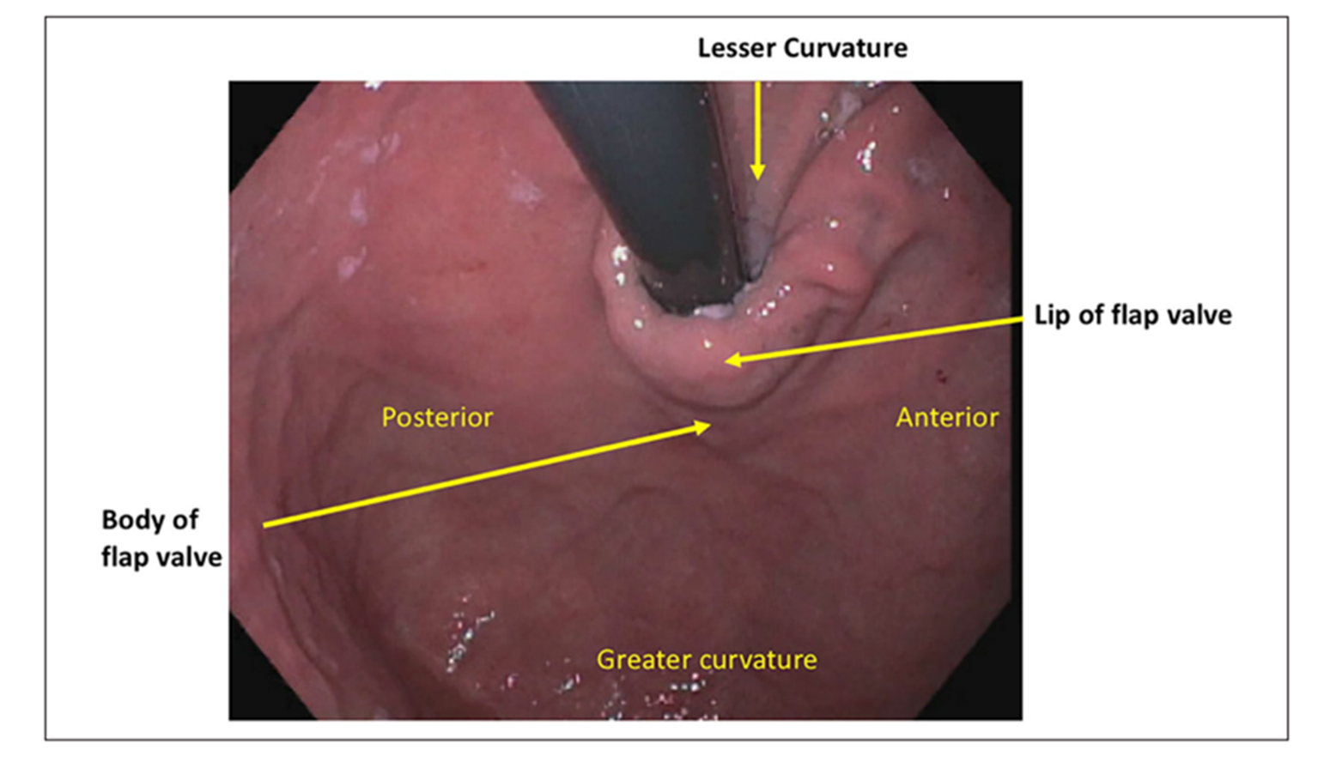
Nguyen et al, 2022
LDF components: hiatal axial length; hiatal aperture measured in centimeters; and the present or absent of a functioning flap valve.
Angrisani 2024

Slide 7
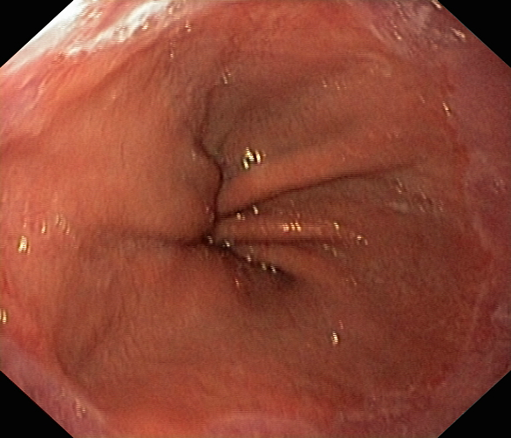
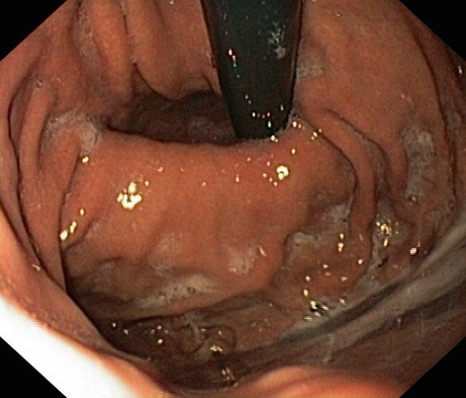
Endoscopic anatomic orientation of the esophagogastric junction
Gastric Folds
Diaphragmatic Plication
Squamo-columnar Junction
Conclusions: Hiatal Hernia (Grade IV according to Hill Classification)
Angrisani 2024
Notes:
HH can be endoscopically diagnosed by measuring the axial length between the squamocolumnar junction and the diaphragmatic pinch or by assessing the gastroesophageal flap valve using the Hill Classification.

Slide 8
HRM CHICAGO 4 PROTOCOL
Supine position
a 60 second adaptation period,
3 deep breaths,
30 second baseline period,
10 five ml wet swallows and
one multiple rapid swallow.
Upright position
a 60 second adaptation,
3 deep breaths,
30 second baseline period,
5 five ml wet swallows
a rapid drink challenge
Angrisani 2024

Slide 9
HIGH RESOLUTION MANOMETRY
Distal contractile integral (DCI) measures the contractile vigor along time and the distance spanning the transition zone and proximal border of the LES. DCI measures the vigor of peristalsis in the smooth muscle esophagus.
ESOPHAGOGASTRIC JUNCTION (EGJ)
ESOPHAGEAL MOTILITY
Angrisani 2024

Slide 10
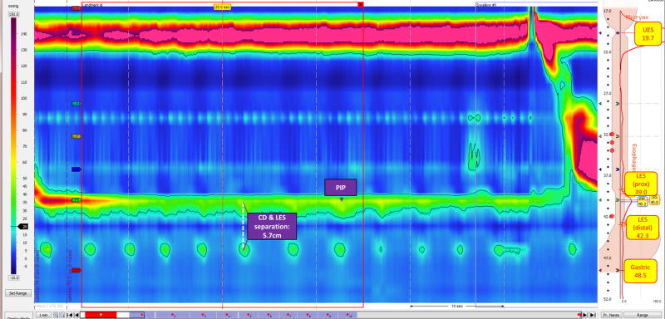
ESOPHAGOGASTRIC JUNCTION (EGJ)
Hiatal Hernia
Angrisani 2024

Slide 11
Ann Surg. 1919 Mar; 69(3): 254–270.
Angrisani 2024

Slide 12
Angrisani 2024

Slide 13
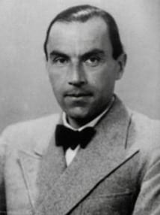
Angrisani 2024

Slide 14
American ,Journal of Digestive Diseases
1961
Angrisani 2024

Slide 15
Angrisani 2024

Slide 16
Angrisani 2024

Slide 17
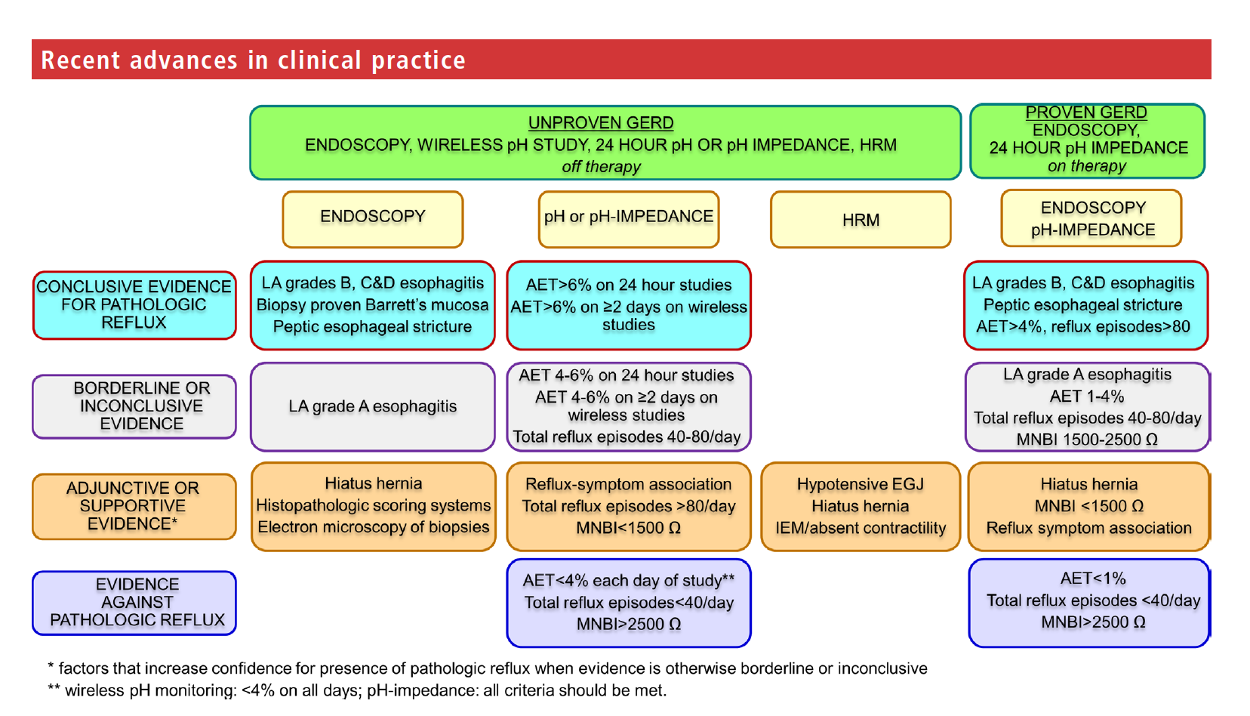
Angrisani 2024
Notes:
Figure 3 Findings that establish conclusive evidence for gastro-oesophageal reflux disease (GERD) can be acquired from endoscopy and/or ambulatory reflux monitoring off therapy in unproven GERD. When evidence is borderline, adjunctive evidence on endoscopy, pH-impedance monitoring and manometry can sway confidence towards or away from conclusive GERD. Findings on pH-impedance
monitoring or wireless pH monitoring can establish absence of GERD, especially when endoscopy is also normal. Similar levels of conclusive, borderline and adjunctive metrics are described for endoscopy and pH-impedance monitoring performed on optimised antisecretory therapy. AET, acid exposure time; HRM, high-resolution
manometry; IEM: ineffective esophageal motilityl LA, Los Angeles; MNBI, mean nocturnal baseline impedance

Slide 18
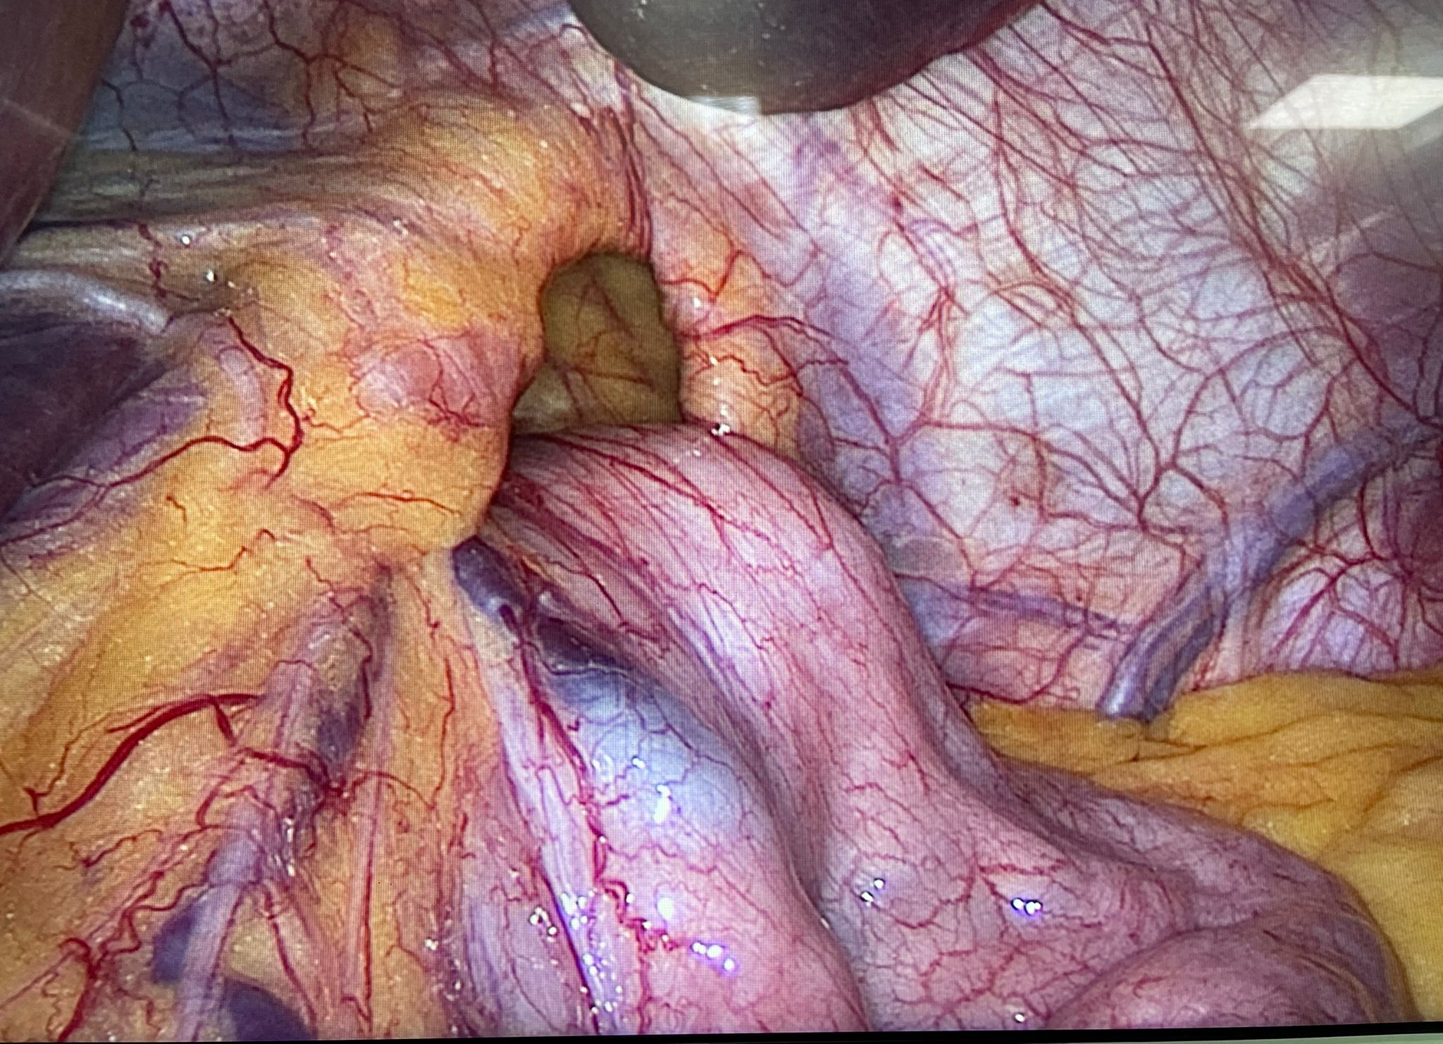
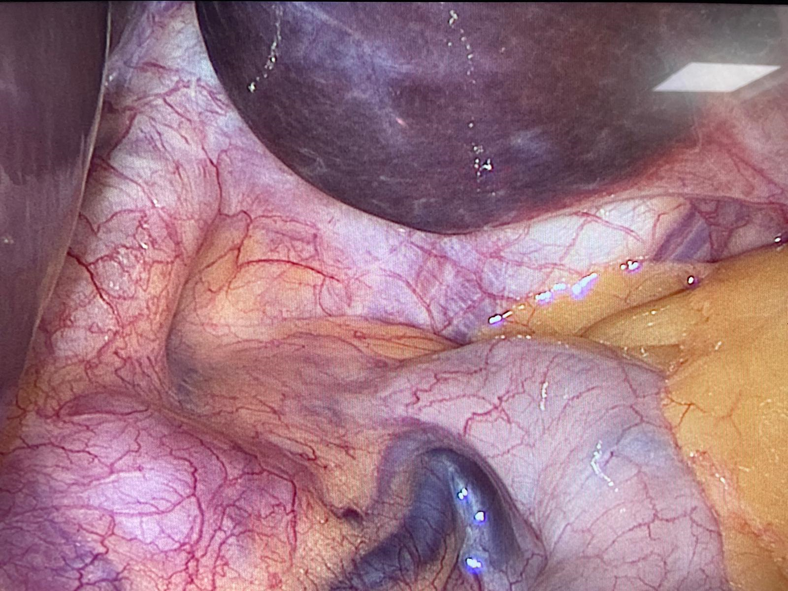
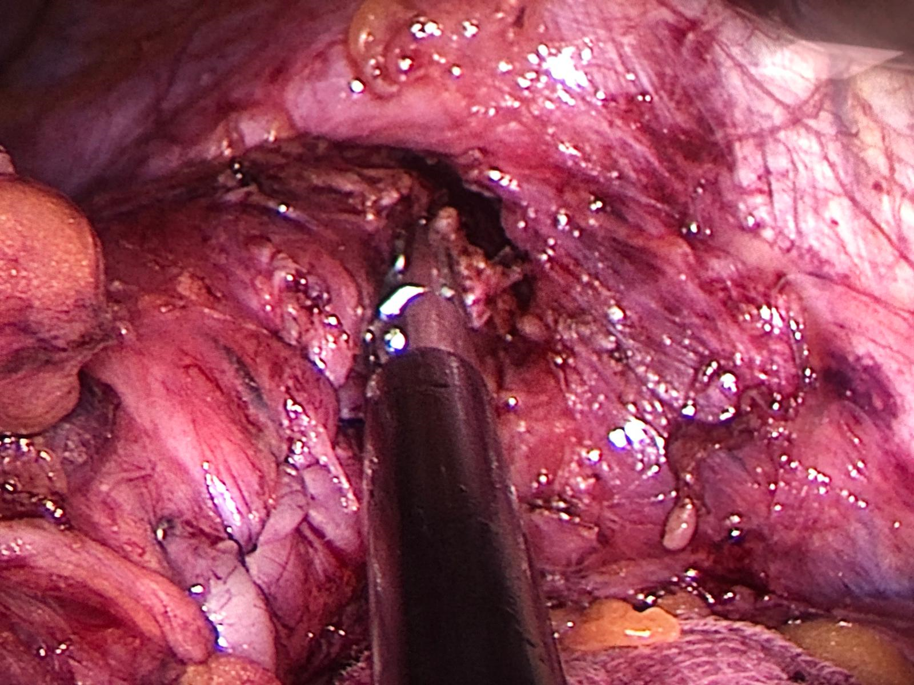
The “Paradigm Shift”
Hiatal Hernia
Laxity of diaphragm
Intrathoracic sleeve migration
Angrisani 2023
Angrisani 2024

Slide 19
INTRAOPERATIVE PROVOCATIVE MANEUVER
Angrisani 2024

Slide 20
Grazie

